Slide 1
Avocci LLC.
Customer Analytics Report
Haelim Kim, Dahyun Choi, Sunpil Howang

Slide 2
Contents
Analysis of customer acquired
by channel
by devices
Analysis for Long term engagement
repeat buyer vs new buyer
power user curve?
Analysis of category
Summary of Recommendation

Slide 3
Introduction
Avoicci LLC. Is a Canadian e-Commerce Company that acquires customers from various channels. Avocci LLC needs solutions and suggests recommendations about the enhance best customer experience. Also, they need strategies to acquire customers and lead to the purchase.

Slide 4
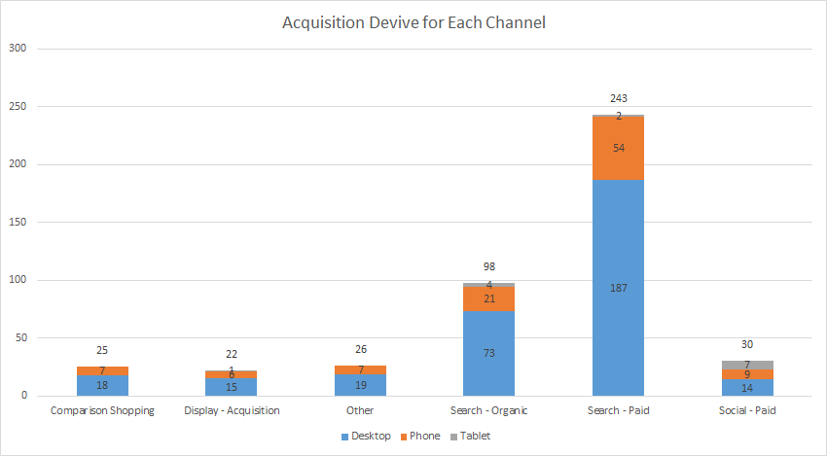
Analysis About the Channel
Overivew of Acquisition Channel and device by ID number
Most users are acquired by the desktop device
The search-paid engine is the most powerful acquisition channel

Slide 5
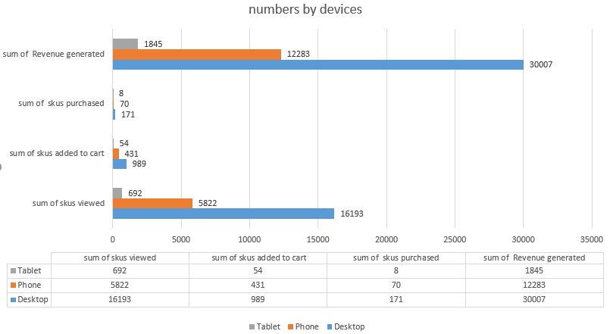
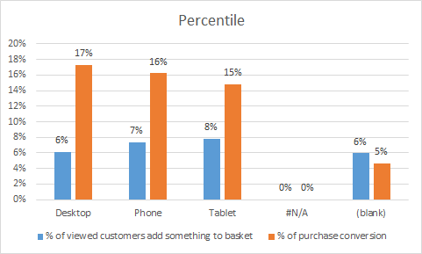
Device Analysis
The most powerful acquisition/revenue-generating channel is the Desktop.
However, when checking up the % of viewed customers who add something to the basket, there is no big difference.
Purchase conversion rate is smaller than Phone and Tablet.

Slide 6
Recommendation
The most powerful acquisition/revenue-generating channel is Desktop
The purchase conversion rate of desktops is smaller than phones and tablets.
To accelerate the purchase,
Desktop
It is important to lead customers to make an actual buy when they are looking(view) for the products.
Add shortcut click sections such as the “buy now” button, pop-up messages for the buying options.
Provide discount coupons and Use Technique of FOMO (Fear of missing out)
Tablet, Phone(Mobile Devices)
The view is much less than desktop but the purchase conversion rate is higher than desktop.
More need to focusing on the acquired of customers. It will be a good idea to start mobile-only promotions- such as sales, free delivery. Also, make or optimize the mobile apps to acquire more users on mobile devices.
Notes:
FOMO -> techinique that is using to consumer psychology. It will encourage visitors to purchase products by creating a humor or sense of urgency. – Great example would be Gilt. Gilt operate the whole business with in Fomo. Can’t miss out things.

Slide 7
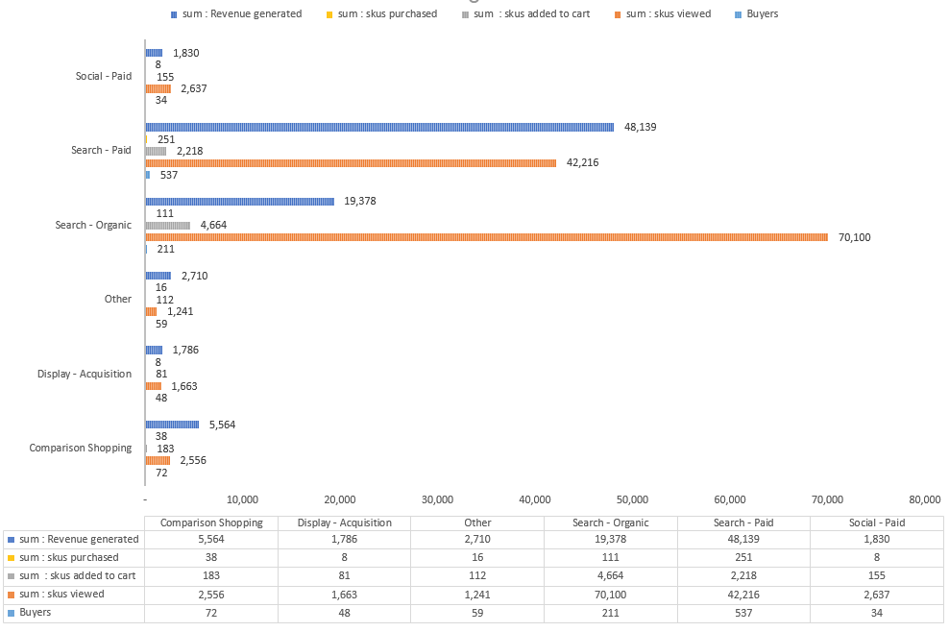
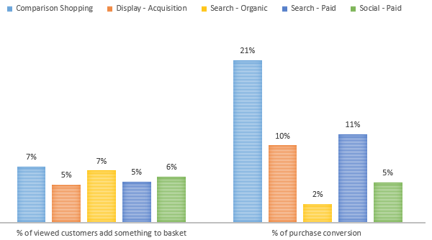
Customer Journey by Channel
Search Organic #1 SKUs View
Search Paid #1 Revenue Generated
Purchase Conversion rate of Search-Organic is 10%
Comparison Shopping has similarity of something to basket rate, but for the purchase conversion rate is overwhelm other channels

Slide 8
Recommendation
Search- paid is Top2 SKUs view but, making most revenue generate and buyer count. So our If the SKUs view is increased, there will be more purchases and make more revenues. although, we have to check the CAC and LTV amount, if the budget is allowed, it will be great to increase the amount of Search-paid channels.
Search organic - Most people look over the product by search organic not really conversion to the purchase rate. To promote this channel, when people looking for something, make shortcuts payment options, time deal coupons ( expired in 10min) to increase the conversion rate.
Comparison shopping - buyer is #3 and also SKUs view is not many compare to search organic and search paid, however, the paid conversion rate is #1. We guess this is because of the character of comparison shopping, customers select our website after making certain decisions compare to another shopping mall. To promote this channel it is a good idea to make a special discount for the compassion sale, also making pop-ups to make reducing the comparing time and products.

Slide 9
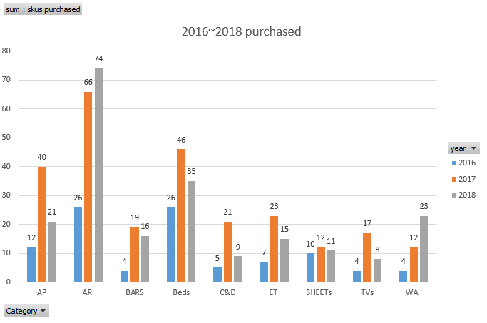
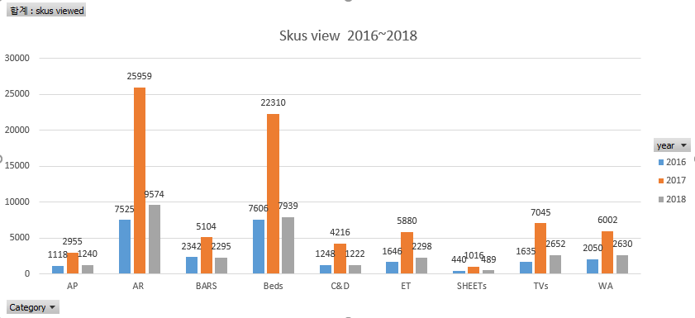
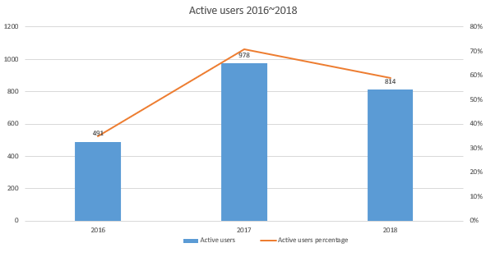
Analysis by Category
SKU view- AR, BED sheets are popular items.
AR, WA the purchase amount increases every year.
For all categories, the SKUs view decreases in the 2018 year.
When checking up the active users, it is possible to assume that this is because of active user rates.

Slide 10
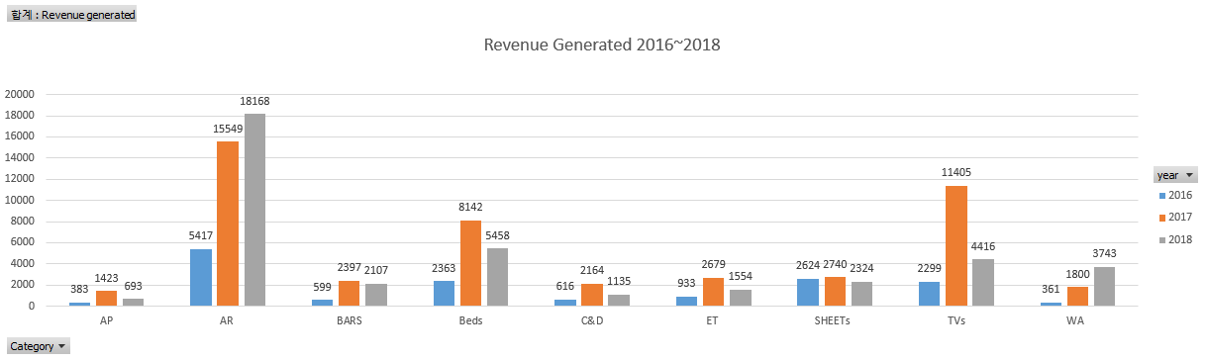
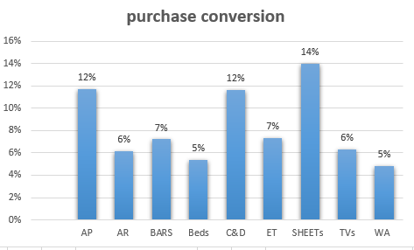
Analysis by Category
AR is the most popular item, the revenue generated amount increases over the year. However, the purchase conversion rate is 6%. For the sheets, the purchase amount is stable and also conversion rate is good. For the AR and WA, purchases increase every year.

Slide 11
Recommendation
SKU view- AR, BED sheets are the most popular items.
AR, WA the purchase amount increases every year. The company should focus on the trend, stock up on the products. Also focusing on an ad, for these products to maintain the increasing trend.
However, for the AR, the purchase conversion rate is only 6%. Also for the bed purchase conversion rate is only 5% Compare to SKUs view, purchase, this is noticeably low. To increase the purchase conversion rate it will good idea for the time-deal sales for the AR, Bed or give the extra point for the AR, Bed buyers to promote purchase. Give many purchase options for customers, allow users to shopping through SNS, and allow guest check out.
Category - sheets have stable purchases and revenue generated. Also, the purchase conversion rate is stable.
It will be a good strategy to subscribe to the sheets for a stable purchase in the future.
For all categories, the SKUs view decreases in the 2018 year. This is because active users are increased in 2017 and decline sharply. The company should check up on the reason for increased and decreased to determine re-increase the active users.
Notes:
너가좀 넣어봐. → give many purchase options for customers, allow users to shopping through SNS, Provide multiple discount options, free return, free shipping, and allow guest check out, lastly provide multiple payment and delivery options

Slide 12
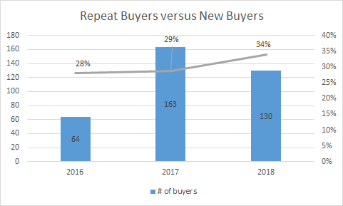
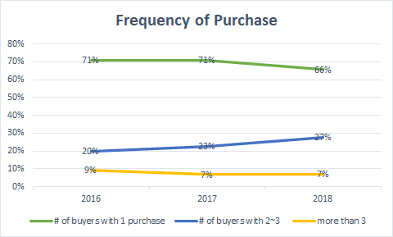
Repeat Buyer vs New Buyers
Repeat customer rate means the customer who makes the purchase more than 2 times in a year.
In 2016, repeat customer is 28%, in 2017 29% and in 2018 34%.
From 2016 to 2018, the repeat customer rate and percentage of retained from the previous year were lower than 30%.

Slide 13
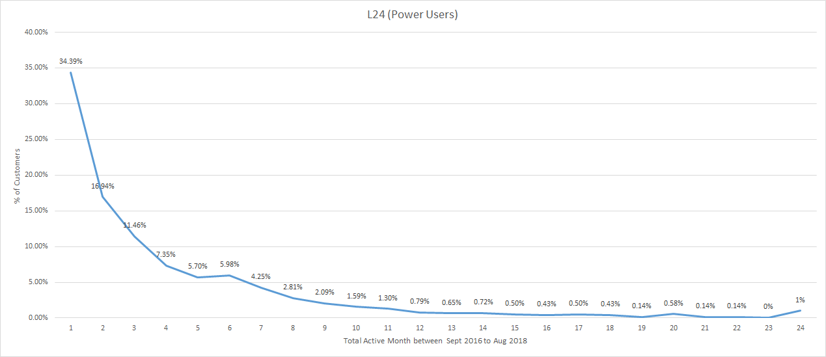
Power Users
The Power-user curve is The graph is a downward curve. This means active users are decreasing. We said a good power user curve is when the graph is smile. When graph is smiling it means there are more active users than past.
Avocci LLC, needs to pay attention to make users keep active.
→ consistently send email with special promotions code, introducing customer loyalty program(starbucks star reward program), SMS Marketing campaign, and referral program.

Slide 14
Recommendation
Above the data, there is an average of 30.3% of repeat buyers. This interprets that the customer does not satisfy the experience in our service.
As there is 30.3% of repeat buyers, which is less than 40%. We recommend turn on acquisition mode.
Repeat buyer rate is low, so acquire a new customer is more effective than focusing on increasing retention rate.
To acquire new customers.
Run referral programs to get new customers and also increasing active users.
It will be a good idea to focusing on search-paid channels based on our analysis of the channel above. Run a promotion for the new customers. free shipping and free returns for the new customers and discount coupons for the next purchase.
Notes:
너가좀 넣어봐. → give many purchase options for customers, allow users to shopping through SNS, Provide multiple discount options, free return, free shipping, and allow guest check out, lastly provide multiple payment and delivery options

Slide 15
Recommendation
For the further steps for the future to long term engagement with customers, also recommend for the increase retention rate:
To increase retention rate, need to provide better customer experiences and make loyalty to the company.
For example, make customers earn points with each purchase. Free shipping and Free return for the subscribed customers.
It is a good idea to send regular commercial mail, send a push notification with the right subject and with good content.
By using Social Media, make our customers make feel engaged in our company. For example, the Instagram, Create an Instagram account and follow the users who following our account and press the like on post who make hashtags or tag our company. Also, provide special campaign for the social media followers.
Notes:
너가좀 넣어봐. → give many purchase options for customers, allow users to shopping through SNS, Provide multiple discount options, free return, free shipping, and allow guest check out, lastly provide multiple payment and delivery options

Slide 16
Summary of Recommendation
Avocci has good channels to acquire more customers.
→ Make shortcut to make purchase.
→ Investment and focus on some channels (Search organic, Search-paid,comparison shopping)
→ Acquire more customers from mobile devices( phone, tablet)
→ Lead customers make actual purchases.
Avocci has popular items and There are items that are growing in popularity.
→ Keep up the trend of growing in popularity on AR, WA products which is growing in popularity.
→ For some products, need to increase conversion rate.
→ Sheets has stable purchasing power, make a strategy sheets become a stable purchasing items.
Customer relationship management need improvement
→ Repeat buyer is less than 40%, run acquisition mode.
→ To make more active users, need strategy for the customer keep engagement with shopping mall.

